Slide 1


Selenium CSS Selector
En çok kullanılan locators

Slide 2
Niçin CSS selectors
id ve name den sonra Kolaydır.(easy)
id ve name den sonra en hızlısıdır.(faster)
id ve name den sonra Tarayıcılar diline en uygun olanıdır.(native)
Web yazılımcıları elemanlarda özellikleri her zaman kullanılır. Bu yüzden kullanışlıdır.
Notes:
Selenium is not just one tool, it’s a collection of tools. We are going to focus on WebDriver, the other two I suggest you research yourself, if we have time at the end of the course I will make a brief introduction

Slide 3
# -> id için
By.cssSelector(‘’#logout’’); // id si logout olan [id='logout']
By.cssSelector(‘’a#logout’’); // a tag lılar için de id si logout olan a[id='logout']
Notes:
Selenium is not just one tool, it’s a collection of tools. We are going to focus on WebDriver, the other two I suggest you research yourself, if we have time at the end of the course I will make a brief introduction

Slide 4
. -> class için
By.cssSelector(‘’.center’’); // [class=‘center’] [class=‘center’]
By.cssSelector(‘’p.center’’); // p tag lılar için de class i center olan
Notes:
Selenium is not just one tool, it’s a collection of tools. We are going to focus on WebDriver, the other two I suggest you research yourself, if we have time at the end of the course I will make a brief introduction

Slide 5
Tag name ile arama
By.cssSelector(‘’input’’); // bütün input taglı olanları seçer.
By.cssSelector(‘’input[type=‘text’]’’); //bütün inputlarda type=‘’text’’ olanları seçer
By.cssSelector(‘’input[type=‘text’][placeholder=‘First Name’]’’) // bütün inputlar içinden type=‘’text’’ ve placeholder=‘’First Name’’ olanı bulur.
By.cssSelector(‘’[type=‘text’]’’); //type=‘’text’’ olanları seçer
By.cssSelector(‘’input.form-control[type=‘text’]’’); //bütün inputlarda class=‘form-control’ olanlardan type=‘text’ olanlar seçer
Notes:
Selenium is not just one tool, it’s a collection of tools. We are going to focus on WebDriver, the other two I suggest you research yourself, if we have time at the end of the course I will make a brief introduction

Slide 6
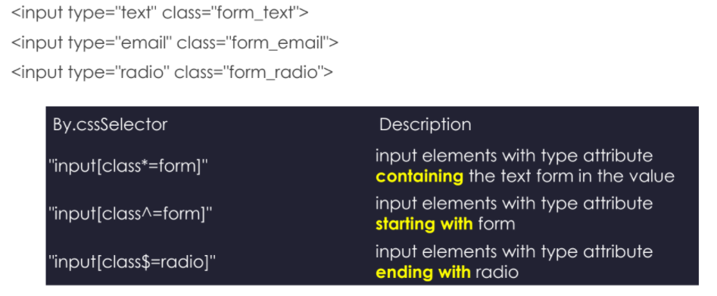
Startwith, endingwith, containing ile arama
* -> İçinde geçen
^ -> ile başlayan
$ -> ile biten
Notes:
Selenium is not just one tool, it’s a collection of tools. We are going to focus on WebDriver, the other two I suggest you research yourself, if we have time at the end of the course I will make a brief introduction

Slide 7
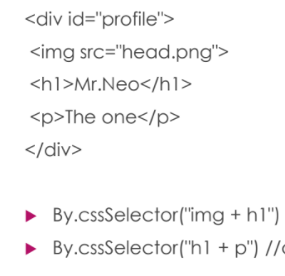
+ ile bitişik(kardeş) elemanı bulma
// öncesinde img tag ı olan h1 tag li elemanı bulur
// öncesinde h1 tag ı olan p taglı elemanı bulur
Notes:
Selenium is not just one tool, it’s a collection of tools. We are going to focus on WebDriver, the other two I suggest you research yourself, if we have time at the end of the course I will make a brief introduction

Slide 8
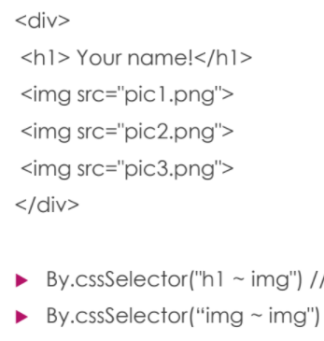
~ ile kardeşlerden elemanı bulma
// öncesinde h1 tag ı olan img tag li elemanı bulur
// öncesinde img tag ı olan img taglı elemanı bulur
Notes:
Selenium is not just one tool, it’s a collection of tools. We are going to focus on WebDriver, the other two I suggest you research yourself, if we have time at the end of the course I will make a brief introduction

Slide 9
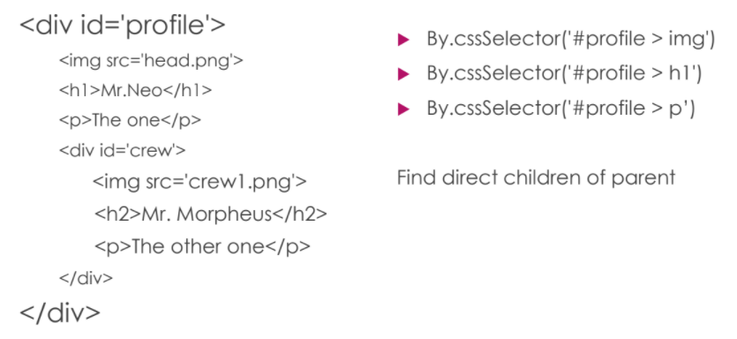
> ile child elemanı bulma (For Children)
Notes:
Selenium is not just one tool, it’s a collection of tools. We are going to focus on WebDriver, the other two I suggest you research yourself, if we have time at the end of the course I will make a brief introduction

Slide 10
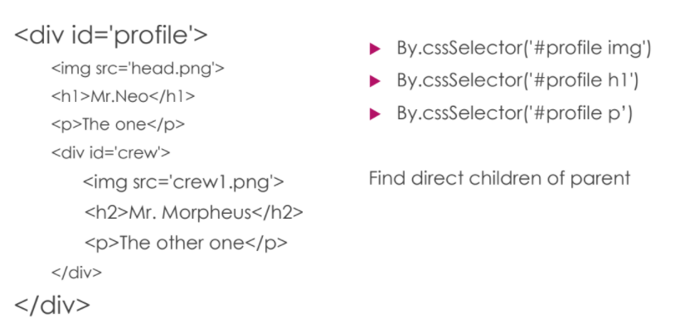
Space ile tum alt elemanlardan bulma
Notes:
Selenium is not just one tool, it’s a collection of tools. We are going to focus on WebDriver, the other two I suggest you research yourself, if we have time at the end of the course I will make a brief introduction

Slide 11
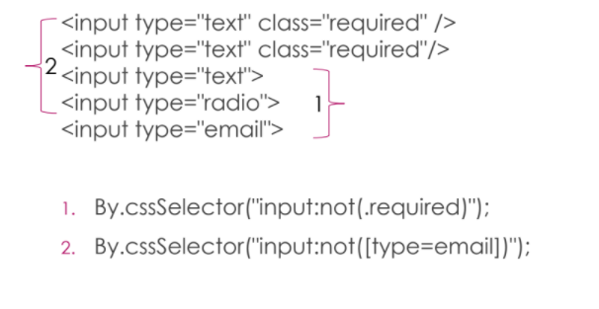
: not
// İnput lardan class ı required OLMAYANLAR
// İnput lardan type ı email OLMAYANLAR
Notes:
Selenium is not just one tool, it’s a collection of tools. We are going to focus on WebDriver, the other two I suggest you research yourself, if we have time at the end of the course I will make a brief introduction

Slide 12
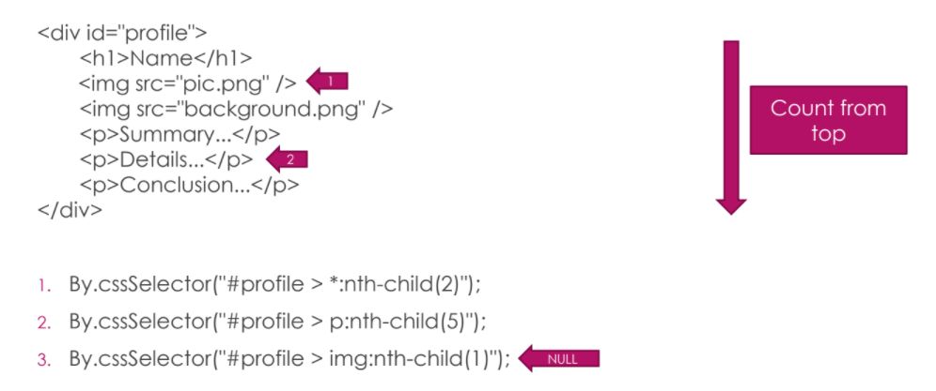
: nth-child :first-child
Notes:
Selenium is not just one tool, it’s a collection of tools. We are going to focus on WebDriver, the other two I suggest you research yourself, if we have time at the end of the course I will make a brief introduction

Slide 13
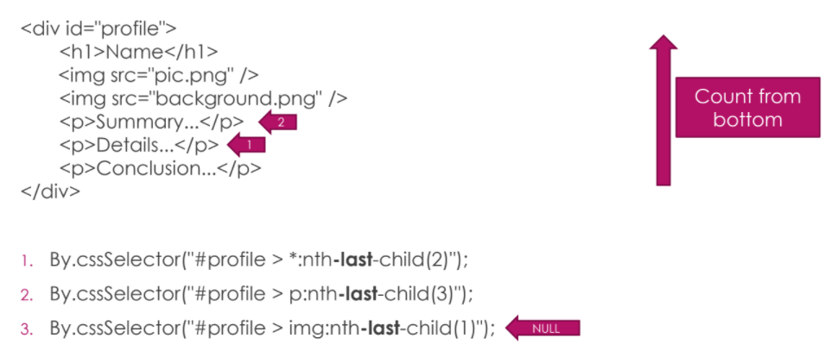
: nth-last-child :last-child
Notes:
Selenium is not just one tool, it’s a collection of tools. We are going to focus on WebDriver, the other two I suggest you research yourself, if we have time at the end of the course I will make a brief introduction

Slide 14
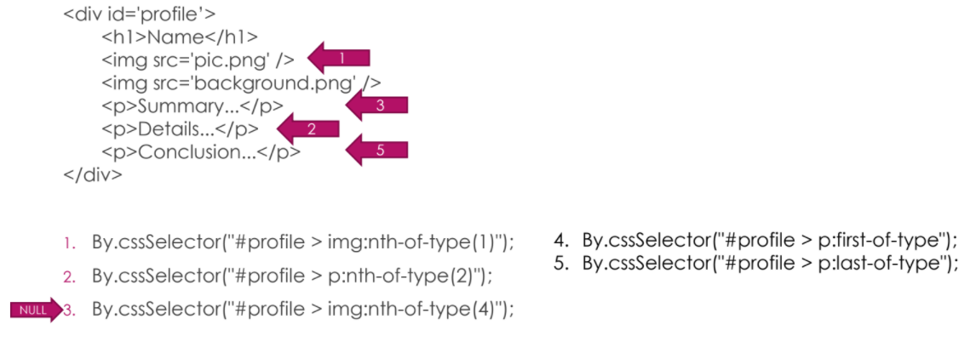
: nth-of-type :nth-last-of-type
4
1- img lardan 1.cisi
2- p lerden 2.si
3- img lardan 4.cüsü var mı? Yok null yani no such element exception
Notes:
Selenium is not just one tool, it’s a collection of tools. We are going to focus on WebDriver, the other two I suggest you research yourself, if we have time at the end of the course I will make a brief introduction

Slide 15
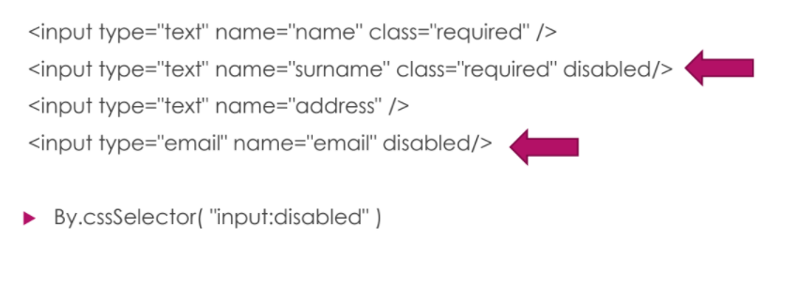
: disable
Notes:
Selenium is not just one tool, it’s a collection of tools. We are going to focus on WebDriver, the other two I suggest you research yourself, if we have time at the end of the course I will make a brief introduction

Slide 16
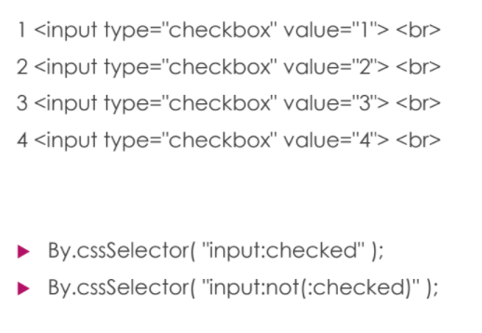
: checked
Notes:
Selenium is not just one tool, it’s a collection of tools. We are going to focus on WebDriver, the other two I suggest you research yourself, if we have time at the end of the course I will make a brief introduction

Slide 17
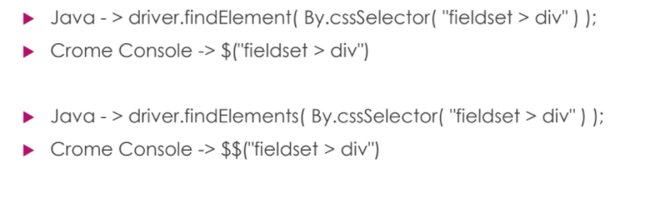
Locator in java & chrome console
Notes:
Selenium is not just one tool, it’s a collection of tools. We are going to focus on WebDriver, the other two I suggest you research yourself, if we have time at the end of the course I will make a brief introduction

